Slide 2
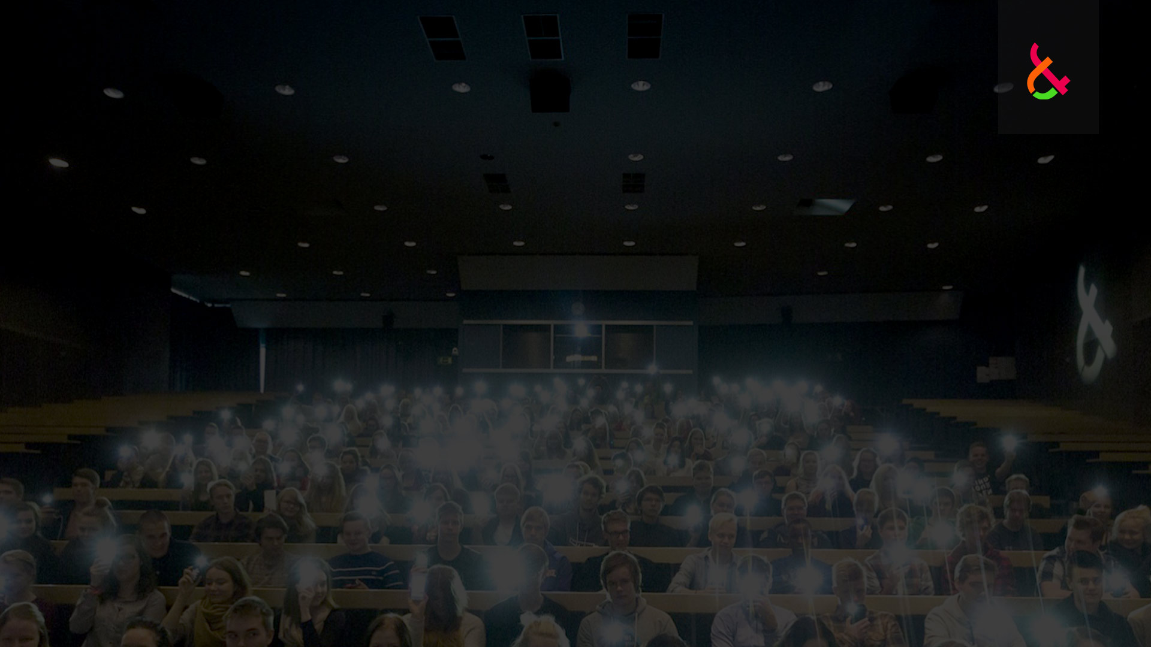
APPLYING TO DOUBLE DEGREE STUDIES in Technology For Partner Universities in Russia
LUT University
December 2, 2019 – February 28, 2020
Studies starting in Fall 2020

Slide 3
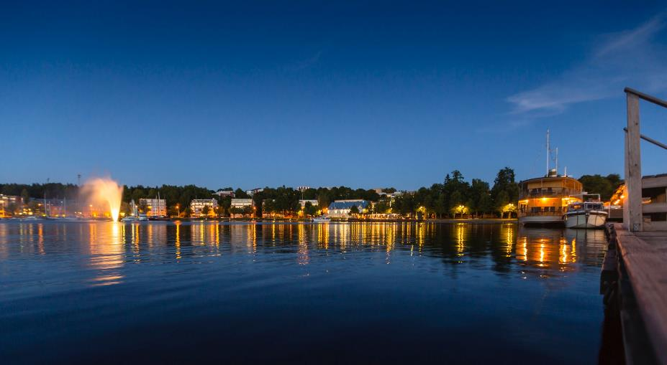
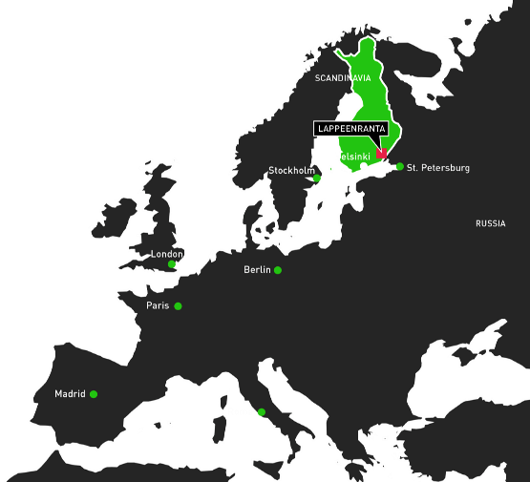
LAPPEENRANTA
International university city
Located by Lake Saimaa
The 4th biggest lake in Europe
Green for Real
Committed to energy efficiency and sustainable development

Slide 4
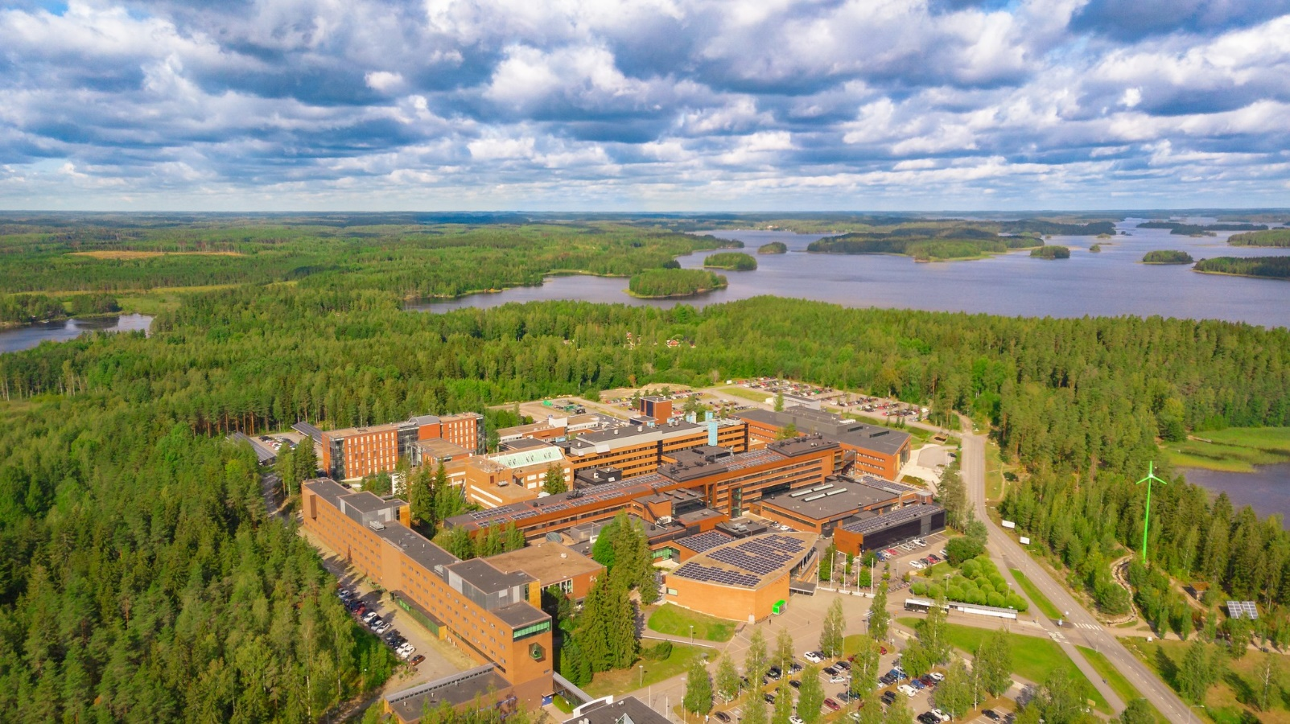
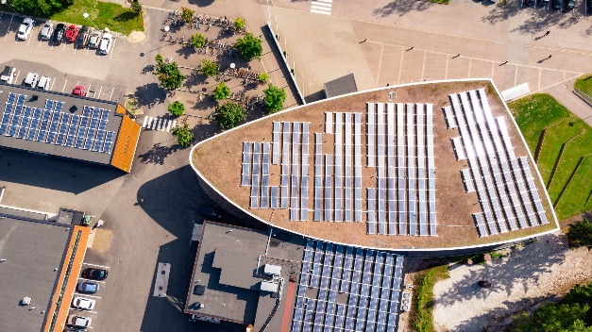
LAPPEENRANTA CAMPUS

Slide 5
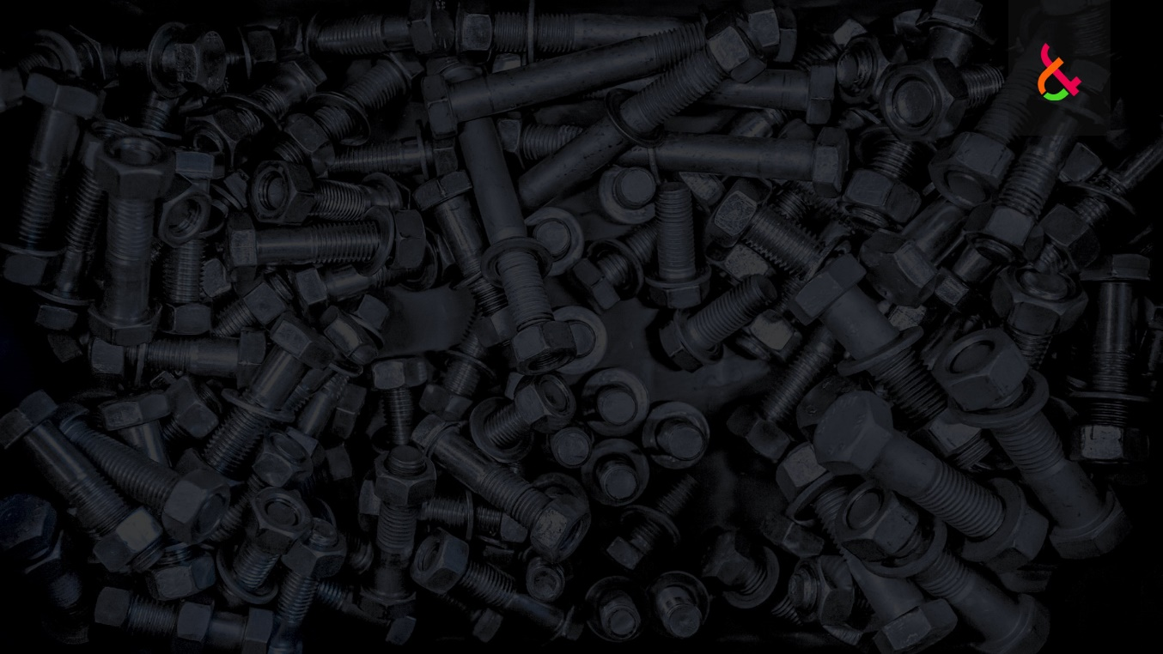
LUT UNIVERSITY IN FIGURES
1969 Founded in 1969, combining Technology and Business
6 000 students
1 000 staff members
70 nationalities
30% of the 1st year students are international

Slide 6
LUT UNIVERSITY RANKINGS
Times Higher Education (THE) University Impact Rankings
The new ranking for THE´s pioneering initiative to recognize universities across the world for their social and economic impact
2019 LUT position 300+ among a total of 462 ranked universities
QS World University Rankings (QS)
Academic reputation, employer reputation, international faculty, citations per faculty member, the student-to-faculty ratio, and the number of international students
2019 LUT position 491 among a total of 1 011 world’s top universities
Special strength: Research intensity
Times Higher Education (THE) World University Rankings
Research, teaching, international outlook, funding
2018 LUT position 501-600 among a total of 1 000 world’s top universities
Special strength: societal impact, particularly in industry collaboration
Firetail: World's Top 20 Challenger Universities
Firetail listed 20 universities around the world that could challenge the academic elite and become globally renowned by the year 2030.
Qualities for all the Top 20 universities: Balance of long-term vision with short-term execution of strategy; clear view of the changing world and their role in it; robust plan to generate the resources, people and culture to be successful; and focus on impact.
LUT is one of the world's 20 most promising and rapidly developing challenger universities / 346 potential rising universities among the ones only, that can sustain their development over the next 15 years will become globally influential.

Slide 7
APPLICATION PERIOD December 2, 2019 – February 28, 2020

Slide 8
LUT UNIVERSITY MASTER’S PROGRAMMES Double Degree Programmes in Technology
LUT School of Energy Systems Master’s Programme in Bioenergy Systems Master’s Programme in Nuclear Engineering Master’s Programme in Electrical Engineering Master’s Programme in Sustainability Science and Solutions Master’s Programme in Mechatronic System Design Master’s Programme in Sustainable Production in Mechanical Engineering Master’s Programme in Advanced Structural Design and Robotised Welding
LUT School of Engineering Science Master’s Programme in Chemical Engineering Master’s Programme in Water Technology Master’s Programme in Computational Engineering and Technical Physics Master’s Programme in Software Engineering and Digital Transformation Master’s Programme in Global Management of Innovation and Technology (GMIT)
A list for partner universities for each LUT Master’s DD Programme can be found at the LUT website “Apply to LUT – Double Degree Studies”

Slide 9
SCHOLARSHIPS
Citizens outside the EU/EEA countries (excluding Switzerland) required to pay a tuition fee of EUR 10 000 / academic year
Possibility to apply for LUT Scholarship
1. Full Scholarship → covering for 100% of the tuition fee + the living expenses up to EUR 560/month (for 10 months/academic year)
2. 100 % Tuition Fee Scholarship → covering for 100% of the tuition fee
3. 50% Tuition Fee Scholarship → covering for 50% of the tuition fee
All the LUT Master’s Programmes are offering scholarships NOTE: All the programmes are NOT offering Full Scholarships
Scholarships granted in the order of the highest points achieved in the selection process Once the Scholarship Decisions are made, there will be no reconsidering done or changes made to them
Applied to on the same application form when applying to the Master's Programme

Slide 11
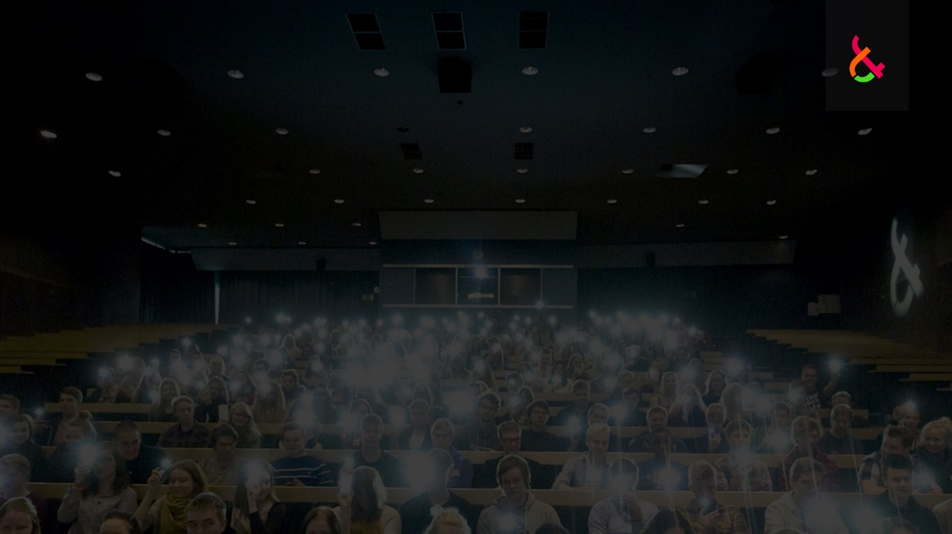
CHOOSING THE PROGRAMME
Start the application process by choosing the relevant LUT Master's Programme/s
More information about the programmes: www.lut.fi/masters
You can apply to a maximum of two different LUT Master’s Programmes for which your home university/faculty has a Double Degree agreement with LUT → A list for the partner universities for each LUT Master’s Programme can be found at the LUT website “Apply to LUT – Double Degree Studies”
Carefully go through the websites for the required programme-specific studies → www.lut.fi → Admissions → Apply to LUT → Master’s Studies → Detailed information given programme by programme

Slide 12
ACCEPTED LANGUAGE TESTS & MINIMUM REQUIRED SCORES
MINIMUM SCORES FOR THE LANGUAGE TEST RESULTS
Chemical Engineering
Water Technology
Software Engineering and Digital Transformation
Global Management of Innovation and Technology (GMIT)
MINIMUM SCORES FOR THE LANGUAGE TEST RESULTS
Bioenergy Systems
Nuclear Engineering
Electrical Engineering
Sustainability Science and Solutions
Mechatronic System Design
Advanced Structural Design and Robotised Welding
Sustainable Production in Mechanical Engineering
Computational Engineering and Technical Physics
Academic TOEFL 80 iBT
Academic IELTS 6.0
PTE Academic 54
Cambridge English CAE C /CPE C
Academic TOEFL 65 iBT Academic IELTS 5.5
PTE Academic 46
Cambridge English CAE C /CPE C
NO LANGUAGE TEST REQUIRED IF:
The previous degree has been completed in English in an EU/EEA country, Australia, Canada, New Zealand or the United States of America OR,
The present Master’s Programme in the partner university is in English

Slide 13
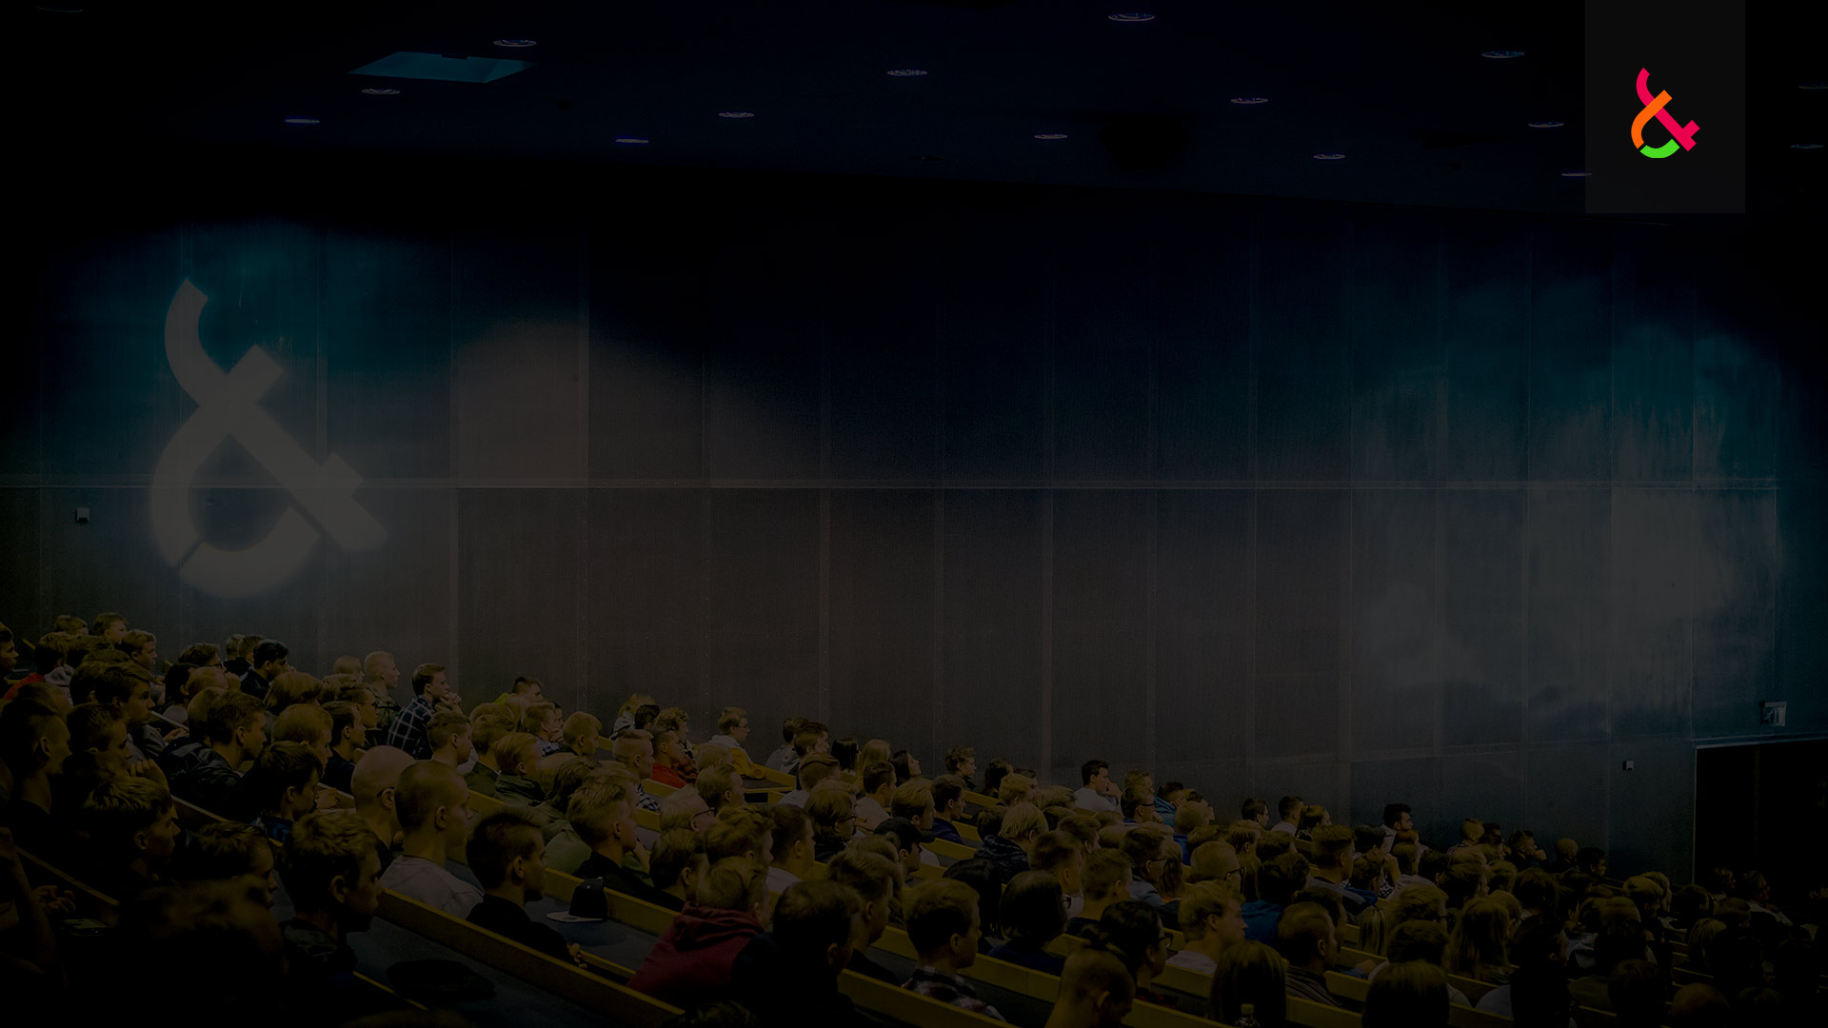
TAKING A LANGUAGE TEST
!! TAKING A LANGUAGE TEST IN ENGLISH AS SOON AS POSSIBLE !!
Only a limited number of tests and test dates are available
Receiving the results usually takes several weeks
Not eligible to apply without an accepted language test result by the application DL
Language test result must reach LUT Admissions Services by February 28, 2020 at 15:00 (UTC+2)
A language certificate provided by the home university is NOT accepted
STUDENTS WHO ARE NOT REQUIRED TO PROVIDE A LANGUAGE TEST RESULT The language of instruction mentioned in the Degree Certificate or ToR – if not, an additional, official* statement by the partner university about the language of instruction required. *The original stamp of the university or faculty on each page of each copy for the documents.

Slide 14
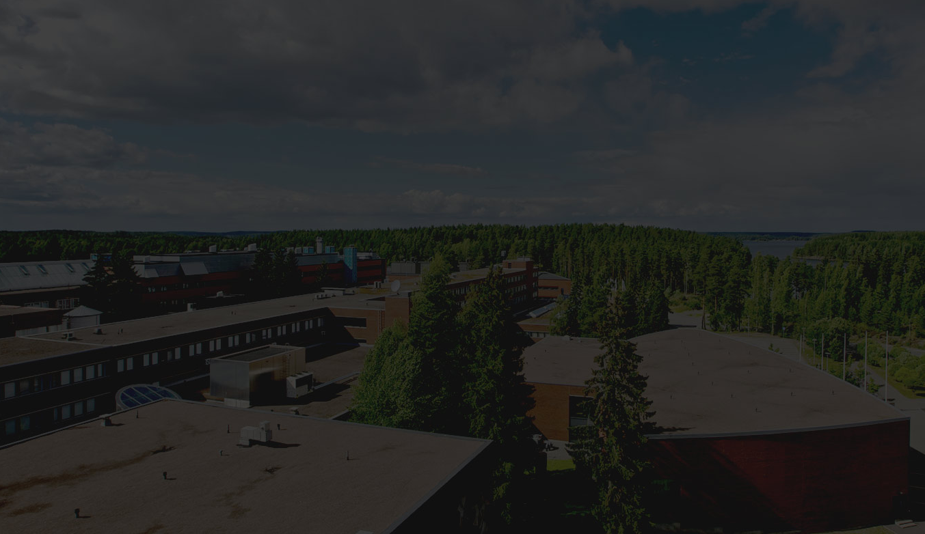
VALIDITY FOR THE LANGUAGE TEST
Test result has to be valid on the first day of the application period = on December 2, 2019
All the accepted language tests are valid for 2 years from the date of taking the test
SUBMITTING THE TEST RESULT
Enclosing a copy of the test result to the application OR, mailing/e-mailing it separately to LUT Admissions Services – or, requesting it to be made electronically available to LUT by the test organizer The codes can be requested from LUT Admissions Services
The test result has to reach LUT Admissions Services by February 28, 2020 at 15:00 (UTC+2)

Slide 15
REQUIRED EDUCATIONAL DOCUMENTS AND AUTHENTICATION

Slide 16
REQUIRED EDUCATIONAL DOCUMENTS
A copy for the Degree Certificate (B.Sc.)
A copy for the Transcript of Records (B.Sc.)
An up-to-date copy for the Transcript of Records (M.Sc.)
+ Translations in English for all these documents (if applicable)

Slide 17
AUTHENTICATION & TRANSLATIONS
ALL COPIES FOR EDUCATIONAL DOCUMENTS
Must be officially certified by the awarding university or the present home university
There has to be the original stamp of the university on each page of each copy for the documents
A plain copy of an officially certified copy is NOT accepted
Or, officially certified by Notary Public
Each page of every document must bear an original stamp/seal and signature of the certifying officer
ALL TRANSLATIONS FOR EDUCATIONAL DOCUMENTS
Can be done by the applicant – but they must be officially certified by the awarding university or the present home university
There has to be the original stamp of the university on each page of the translations
A translation without the original stamp of the university NOT accepted
…Or, the educational documents can also be translated by an official translator
Each page of every document must bear an original stamp/seal and signature of the official translator

Slide 18
APPLICATION PROCESS
December 2, 2019 – February 28, 2020

Slide 19
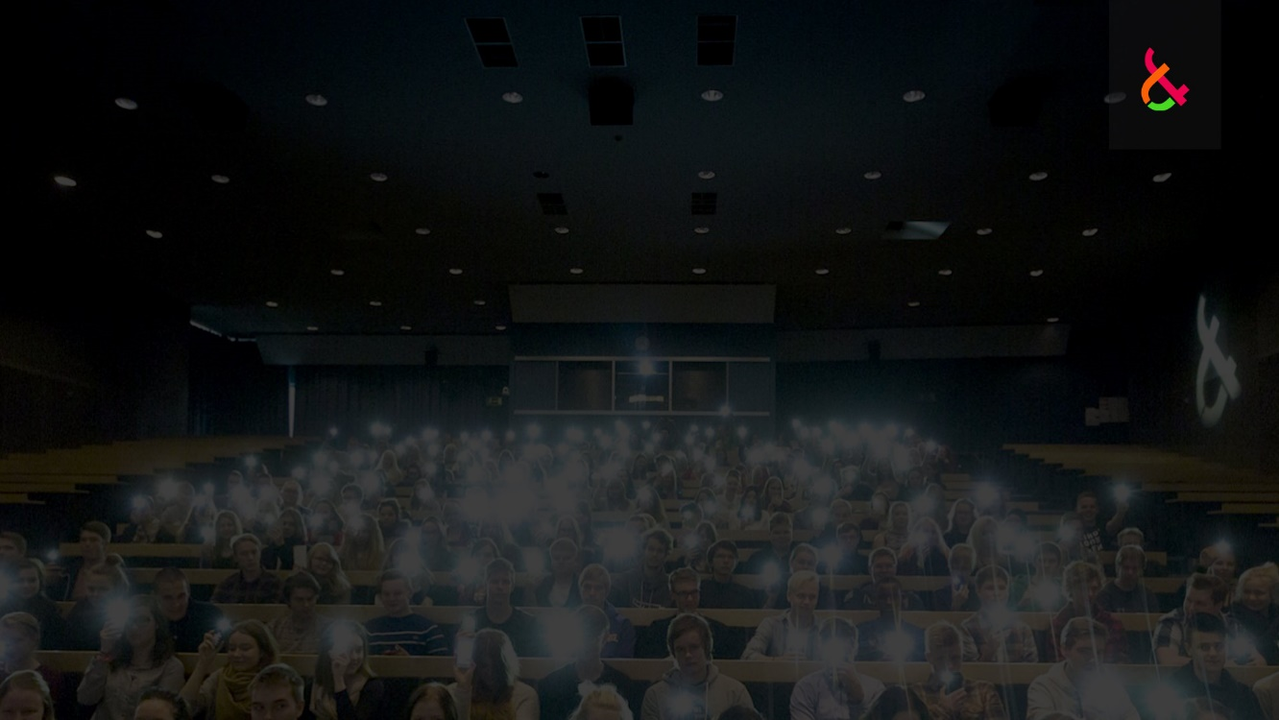
HOW TO APPLY? How Does It All Start?
A contact person in the home university will first provide LUT Admissions Services with a list of students applying to the programme
→ Students & status for the language test (if applicable)
LUT Admissions Services will send the student a link to his/her personal application form

Slide 20
HOW TO APPLY? Application Forms & Enclosures
NOTE! The application documents will not be returned or accessed by the applicant anymore after having been received by LUT University
Filling in the application form and submitting it online
Printing it out and signing it
Enclosing all the required and officially certified documents → Listed on the application form
One application form for each programme (max. 2 programmes)
One set of enclosures required for each programme

Slide 21
DELIVERING THE APPLICATION
APPLICANTS IN ST. PETERSBURG
Bring your application in a closed envelope addressed to LUT Admissions Services to the LUT staff member at “The House of Finland” in St. Petersburg
Schedules for bringing the documents informed to all the applicants
The documents will not be checked at The House of Finland
APPLICANTS IN OTHER CITIES
Mailing the application form + the enclosures to LUT Admissions Services by using a courier service
Address given on the application form
DL for LUT Admissions Services to receive the application form + all the required documents is February 28, 2020 at 15:00 (UTC+2)
No additional supplementary period
Late applications will not be accepted

Slide 22
AFTER YOUR APPLICATION
HAS REACHED LUT

Slide 23
VERIFYING THE ELIGIBILITY
LUT Admissions Services will first verify the eligibility and language skills
Only when the language requirements are met with, LUT Admissions Services will process the educational documents
LUT Admissions Services will notify the applicant by e-mail when having processed the documents
…and send him/her a request to supplement the application, if necessary
The student has to be able to supplement the application by the application DL of February 28, 2020 at 15:00 (UTC+2)
= No additional supplementary period after the DL
Applications NOT being enclosed/supplemented with the requested documents by the given DL will automatically be rejected as incomplete applications

Slide 24
EVALUATIONS & INTERVIEWS
Limited number of Double Degree applicants to be admitted to each programme
Applications evaluated by the Admissions Committee for the programme
All the eligible applicants will go through a video interview as part of the evaluation/selection process To be admitted, an eligible Double Degree applicant must score at least 70% of the maximum points for the interview

Slide 25
STUDENT SELECTIONS
LUT student selections will be published on April 8, 2020
Admitted students will be first informed by e-mail about the admission and scholarship decision
Admitted students in St. Petersburg: Students can pick up their Admission Letter at the House of Finland
Admitted students in other cities: Admission Letters will be sent to the contact person in the home university
If having been granted a scholarship, the official Scholarship Decision will be enclosed as well
Non-admitted applicants will be informed by e-mail

Slide 26
ALL ADMITTED STUDENTS
Confirming the offered LUT study place by April 30, 2020
Studies starting at the end of August 2020
The exact date given on the Certificate of Admission

Slide 27
FURTHER INFORMATION
LUT Admissions Services admission@lut.fi

